Slide 1
Cascading Style Sheet
By : Tamal Dey
Assistant Professor
Dept. of MCA, PESU

Slide 2
Topics
Introduction
Levels of style sheet
Style specification formats
Selector Forms
Property value forms
Font properties
List properties
Color
Alignment of text
The Box model
Background Images
The <span> and <div> tag
Conflict resolution
5 Advantages of CSS:
http://www.networksolutions.com/education/css-web-design-advantages/

Slide 3
Introduction
The CSS1 specification was developed in 1996
CSS2 was released in 1998
CSS3 is on its way since1999 (CSS3 – the text shadows, borders with images, opacity, multiple backgrounds, etc,)
CSS provides the means to control and change presentation of HTML documents
CSS is not technically HTML, but can be embedded in HTML documents
Style sheets allow you to impose a standard style on a whole document, or even a whole collection of documents
Style is specified for a tag by the values of its properties

Slide 4
CSS (Cascading Style Sheets)
Styles define how to display HTML elements
Styles are normally stored in Style Sheets
Styles were added to HTML 4.0 to solve a problem. CSS Saves a Lot of Work!
External Style Sheets are stored in CSS files as ".css“
Multiple style definitions will cascade into one
syntax:
  Style = “property_1:value_1; property_2:value_2; property_n:value_n;”

Slide 5

CSS Syntax CSS1 or CSS2
A CSS rule has two main parts:
  a selector
  one or more declarations:
The selector is normally the HTML element you want to style.
Each declaration consists of a property and a value.

Slide 6
There are three levels of style sheets
Inline - specified for a specific occurrence of a tag and apply only to that tag
Document-level style sheets (internal) - apply to the whole document in which they appear
External style sheets - can be applied to any number of documents
When more than one style sheet applies to a specific tag in a document, the lowest level style sheet has precedence.
In a sense, the browser searches for a style property specification, starting with inline, until it finds one (or there isn’t one)

Slide 7
Inline style sheets appear in the tag itself
Document-level style sheets appear in the head of the document
External style sheets are in separate files, potentially on any server on the Internet
  Written as text files with the MIME type text/css
  A <link> tag is used to specify that the browser is to fetch and use an external style sheet file
  <link rel = "stylesheet" type = "text/css"
  href = "http://www.wherever.org/termpaper.css">
  </link>
External style sheets can be validated
  http://jigsaw.w3.org/css-validator/#validate_by_upload

Slide 8
Three Ways to Insert CSS
Inline style
  <p style="color:sienna; margin-left:20px;">
  This is a paragraph.</p>
Internal style sheet
  <head>
  <style type="text/css">
  hr {color: gray;}
  p {margin-left: 20px;}
  body { background-image :url("images/back40.gif"); }
  </style>
  </head>
External style sheet
  <head>
  <link rel="stylesheet" type="text/css" href="mystyle.css" />
  </head>
  @import url(filename);

Slide 9
Style Specification Formats
Format depends on the level of the style sheet
Inline:
  Style sheet appears as the value of the style attribute
  General form:
style = "property_1: value_1;
property_2: value_2;
…
property_n: value_n"

Slide 10
Document-level:
  Style sheet appears as a list of rules that are the content of a <style> tag
  The <style> tag must include the type attribute, set to "text/css“
  The list of rules must be placed in an HTML comment, because it is not HTML
  Comments in the rule list must have a different form - use C comments (/*…*/)
General form:
<style type = "text/css">
<!-- rule list -->
</style>

Slide 11
Form of the rules:
  selector {list of property/values}
Each property/value pair has the form:
  property: value
Pairs are separated by semicolons, just as in the value of a <style> tag
External style sheets
  Form is a list of style rules, as in the content of a <style> tag for document-level style sheets

Slide 12
/*This is a comment*/
body {
body {background-image:
url(“paper.gif”);}
}
h1
{
color:orange;
text-align:center;
}
p{font-family:"Times New Roman";
font-size:20px;}
This is the style sheet file (ex1.css):
body{background-color:yellow;}
h1{font-size:36pt;}
h2{color:blue;}
p{margin-left:50px;}

Slide 13
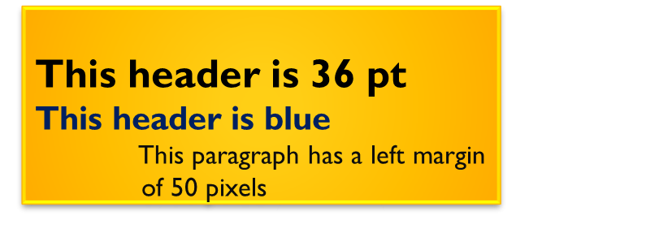
An external style sheet with the <link> tag
  <html>
  <head>
  <link rel="stylesheet" type="text/css" href="ex1.css" />
  </head>
  <body>
  <h1>This header is 36 pt</h1>
  <h2>This header is blue</h2>
  <p>This paragraph has a left margin of 50 pixels</p>
  </body>
  </html>

Slide 14
Selector Forms
Simple Selector forms
  descendant selector
Class Selectors
Generic selector
id Selectors
Universal Selectors
Pseudo Classes
HTML +CSS: http://www.htmlcodetutorial.com/
HTML 5 +CSS : http://www.quackit.com/html_5/

Slide 15
Example
1. Simple Selector Forms
A simplest selector form is a single element name such as h1
The property value and rule applies to all occurrences of the named element
The selector is a tag name or a list of tag names, separated by commas
  Examples:
    h1, h3, p
    h1 {font-size: 24pt;}
    h2, h3 {font-size: 20pt;}

Slide 16
1.1.Contextual selectors
  Selector can specify that style should apply to the element of certain position in the document
Only applies its style to the content of emphasis (give extra weight) elements that are descendent to the bold element that applies in the body of document
    body b em {font size: 14pt;}
      I can <b><em>not</em></b> emphasise this enough!
      O/p: I can not emphasise this enough!
The contextual / descendent selector applies to the content of a emphasis element that have boldface element in body of the document not its ancestor. Contextual element are also called a descendant selector.

Slide 17
2. Class Selectors
Used to allow different occurrences of the same tag to use different style specifications
A style class has a name, which is attached to a tag name with a period
  For example,
    p.narrow {property-value list}
    p.wide {property-value list}
The class you want on a particular occurrence of a tag is specified with the class attribute of the tag
For example,
<p class = "narrow">
This is a narrow paragraph</p> ...
<p class = "wide">
This is a wide paragraph</p>

Slide 18
3. Generic Selectors
  A generic class can be defined if you want a style to apply to more than one kind of tag
  A generic class must be named, and the name must begin with a period
Example,
    . really-big {property-value list}
    Or
    . sale {property-value list}
Use it as if it were a normal style class
<h1 class = "really-big"> … </h1>
...
<p class = "really-big"> … </p>

Slide 19
4. id Selectors
An id selector allow the application of a style to one specific element
  General form:
    #specific-id {property-value list}
  Example:
    #section14 {font-size: 20}
  Specifies
    <h2 id =“section14”>1.4 Black Cats </h2>

Slide 20
5. Universal selectors
Denoted by (*) asterisk applies its style to all the element
  * { color: red; }
  Example ALL

Slide 21
6. Pseudo Classes
Pseudo classes are styles that apply when something happens rather than because the target element simply exists
  Names begin with colons (:)
  hover classes apply when the mouse cursor is over the element
  focus classes apply when an element has focus
  Example 1 2

Slide 22
<!-- pseudo.html -->
<html xmlns = "http://www.w3.org/1999/xhtml">
<head> <title> Checkboxes </title>
<style type = "text/css">
input:hover {color: red;}
input:focus {color: green;}
</style>
</head>
<body>
<form action = "">
<p>Your name:
<input type = "text" />
</p>
</form>
</body>
</html>

Slide 23
Property Value Forms
There are 60 different properties in 7 categories:
  Fonts
  Lists
  Alignment of text
  Margins
  Colors
  Backgrounds
  Borders
Property Value Forms
  Keywords - left, large , medium, small, …
  Not case sensitive

Slide 24
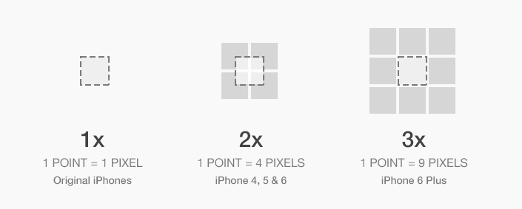
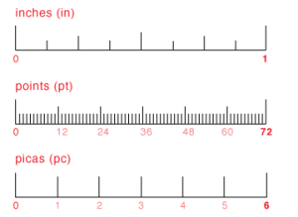
Property Value Forms
Length - numbers, maybe with decimal points
Units:
  px - pixels
  in – inches
  cm - centimeters
  mm - millimeters
  pt – points (1/72 inch)
  pc - picas (12 points)
  em – 16 points wide
    No space is allowed between the number and the unit specification
    e.g., 1.5 in is illegal!

Slide 25
Property Value Forms
Percentage - just a number followed immediately by a percent sign. E.g.- 75%
  URL values
    url(protocol://server/pathname)
    url (tetons.jpg)
  Colors
    Color name
    rgb(n1, n2, n3)
      http://www.rapidtables.com/web/color/RGB_Color.htm
    Powder blue,light salmon,
  Numbers can be decimal or percentages
  Hex form: #XXXXXX
Property values are inherited by all nested tags

Slide 26
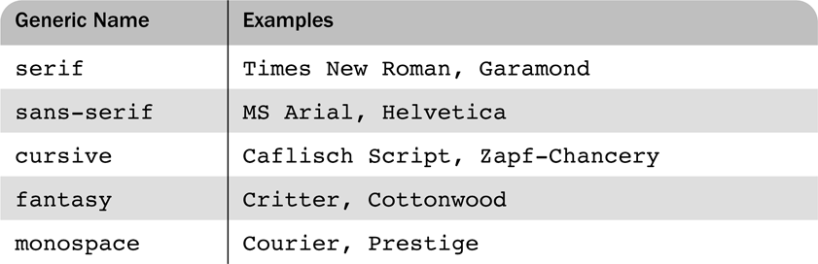
Font Properties
font-family
  Value is a list of font names - browser uses the first in the list it has
  font-family: Arial,Helvetica,Courier
Generic fonts: serif, sans-serif, cursive, fantasy, and monospace (defined in CSS)

Slide 27
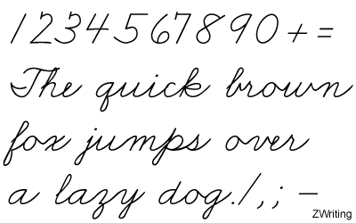
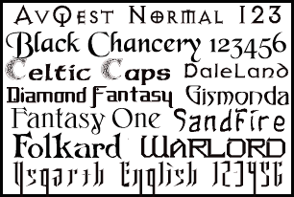

Slide 28
Font Properties
letter-spacing – value is any length property value
  Browser has a specific font for each
  If a font name has more than one word, it should be single-quoted
font-size
  Possible values: a length number or a name, such as smaller, xx-large, font-size:10pt etc.
font Variants
  Usual character font is normal
    small-caps
font-style
  italic, oblique

Slide 29
font-weight - degrees of boldness
  bolder, lighter, bold, normal
  Could specify as a multiple of 100 (100 – 900)
  400 is same as normal and 700 is same as bold.
Example0
text-decoration property –
  line-through,
  Overline
  underline, none
Example

Slide 30

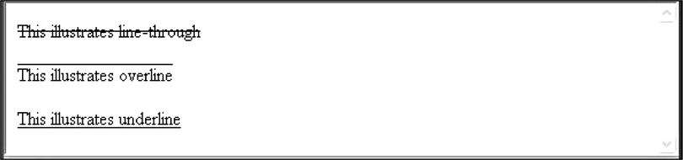
Figure 1 Display of fonts.html
Figure II Display of decoration.html

Slide 31
Font Shorthand's
font
  For specifying a list of font properties
    font: italic lighter 16pt 'Times New Roman';
    font: bold 14pt ‘Times New Roman’ Palatino
  Order must be:
    Font weight, variant, style, size, family
  Example1(Inline) Example I I(External)
General default sizes of headers
  h1: 200%
  h2: 150%
  h3: 120%
  h4: 100%
  h5: 90%
  h6: 60%

Slide 32
List properties
list-style-type
Unordered lists
  Bullet can be a disc (default), a square, or a circle
  Set it on either the <ul> or <li> tag, on <ul>, it applies to list items
  ul { list-style-type: square}
  <h3> Some Common Single-Engine Aircraft </h3>
<ul style = "list-style-type: square">
<li> Cessna Skyhawk </li>
<li> Beechcraft Bonanza </li>
<li> Piper Cherokee </li>
</ul>

Slide 33
On <li>, list-style-type applies to just that item
<h3> Some Common Single-Engine Aircraft </h3>
<ul>
<li style = "list-style-type: disc">
Cessna Skyhawk </li>
<li style = "list-style-type: square">
Beechcraft Bonanza </li>
<li style = "list-style-type: circle">
Piper Cherokee </li>
</ul>

Slide 34
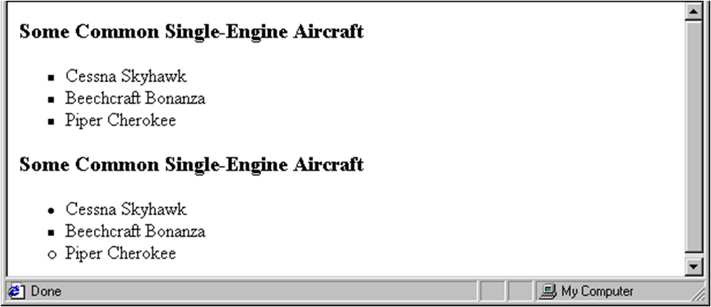
Examples of unordered lists

Slide 35
Class specification
  li.disc {list-style-type: disc}
  li.square {list-style-type: square}
  li.circle {list-style-type: circle}
Inserting Image list
  List-style-image property
  li.image {list-style-image: url(small_airplane.gif)

Slide 36
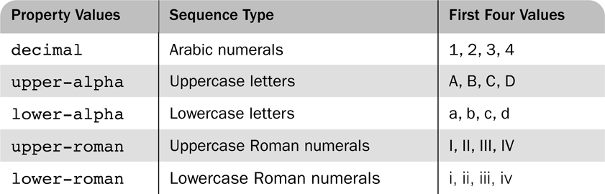
Table Possible sequencing values for ordered lists
List-style-type property

Slide 37
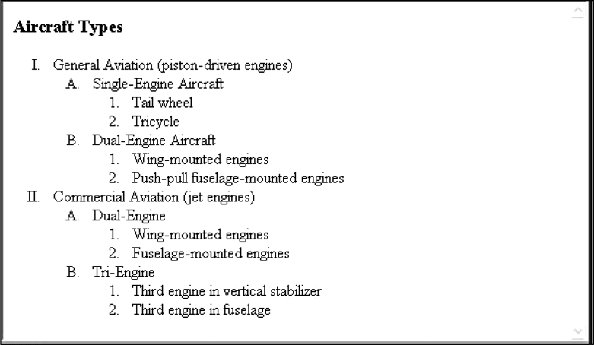
Display of sequence_types.html

Slide 38
Could use an image for the bullets in an unordered list
Example:
<li style ="list-style-image:url(bird.jpg)">
On ordered lists - list-style-type can be used to change the sequence values
CSS2 has more, like lower-greek and hebrew

Slide 39
Colors
Color is a problem for the Web for two reasons:
1. Monitors vary widely
2. Browsers vary widely
There are three color collections Example:
1. There is a set of 16 colors that are guaranteed (named colors) to be displayable by all graphical browsers on all color monitors
black 000000 green 008000
silver C0C0C0 lime 00FF00
gray 808080 olive 808000
white FFFFFF yellow FFFF00
maroon 800000 navy 000080
red FF0000 blue 0000FF
purple 800080 teal 008080
fuschia FF00FF aqua 00FFFF

Slide 40
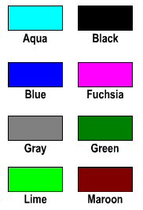
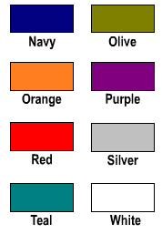

Colors...
      http://www.rapidtables.com/web/color/RGB_Color.htm

Slide 41
Alignment of Text
The text-indent property allows indentation
Takes either a length or a % value Example:
The text-align property has the possible values, left (the default), center, right, or justify
Sometimes we want text to flow around another element - the float property
The float property has the possible values, left, right, and none (the default)
If we have an element we want on the right, with text flowing on its left, we use the default text-align value (left) for the text and the right value for float on the element we want on the right
Float 1 Float-2

Slide 42
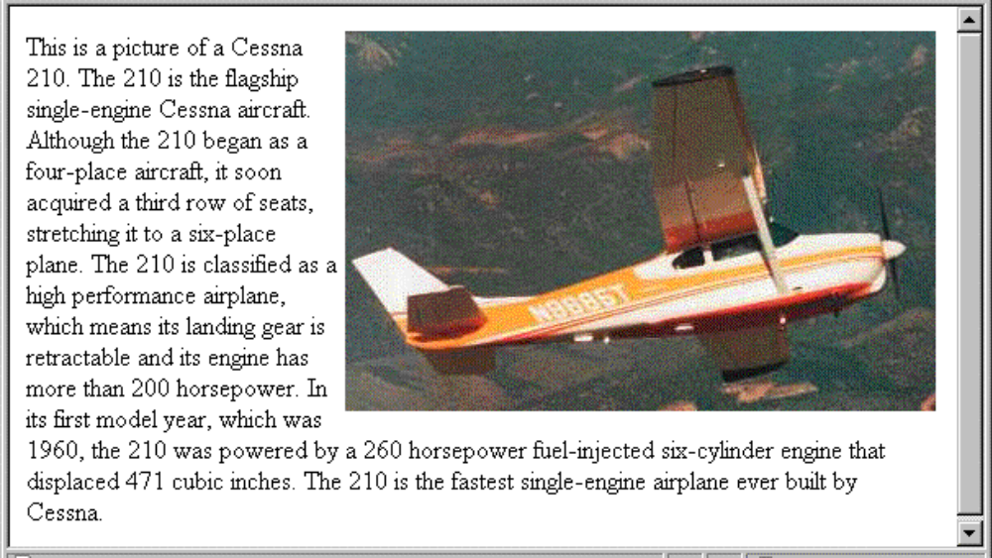
<img src="c210.jpg”style = "float: right"/>
  Some text with the default alignment - left

Slide 43



Web Page Document
Outer Edge
Margin
Border
Padding
Inner Edge
Content

Slide 44
The Box Model
Borders – every element has a border-style property
Controls whether the element has a border and if so, the style of the border
border-style values: none, dotted, dashed, and double
border-width – thin, medium (default), thick, or a length value in pixels
Border width can be specified for any of the four sides (e.g., border-top-width)
border-color – any color
Border color can be specified for any of the four borders (e.g., border-top-color)
  borders.html Border Style Border more style

Slide 45
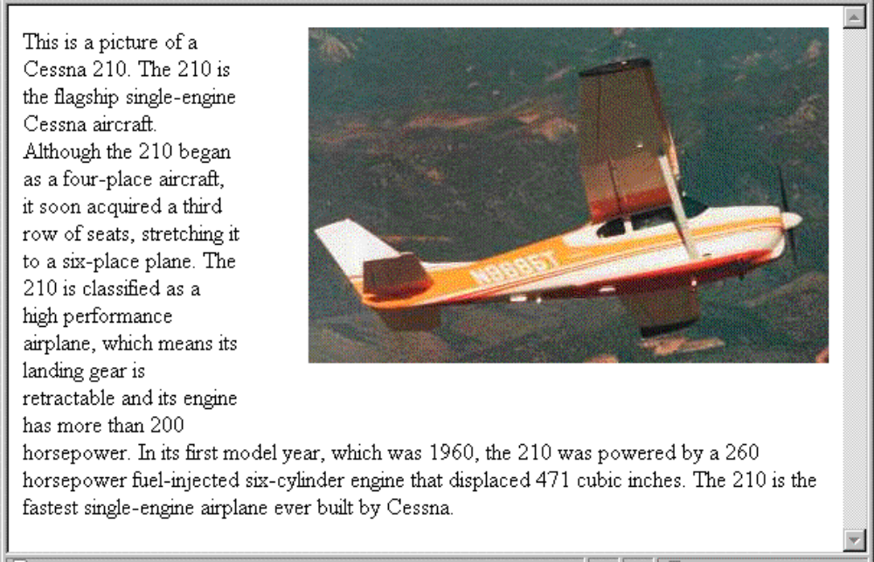
Margin – the space between the border of an element and its neighbor element
The margins around an element can be set with margin-left, etc. - just assign them a length value
<img src = “Plane.png" style = "float: right;
margin-left: 0.35in;margin-bottom: 0.35in" />

Slide 46
Padding – the distance between the content of an element and its border
Controlled by padding, padding-left, etc.
marpads.html and display

Slide 47
Background Images
The background-image property
  back_image.html and display
Repetition can be controlled
  background-repeat property
Possible values: repeat (default), no-repeat, repeat-x, or repeat-y
background-position property
Possible values: top, center, bottom, left, or right
Example Diff. Selectors

Slide 48
The <span> and <div> tags
One problem with the font properties is that they apply to whole elements, which are often too large
Solution: a new tag to define an element in the content of a larger element - <span>
The default meaning of <span> is to leave the content as it is
<p>
Now is the <span> best time </span> ever!
</p>
Span1 Example
Span2 Example

Slide 49
Use <span> to apply a document style sheet to its content
<style type = "text/css">?
.bigred {font-size: 24pt;
font-family: Ariel; color: red}
</style>
<p>
Now is the
<span class = "bigred">
best time </span> ever!
</p>

Slide 50
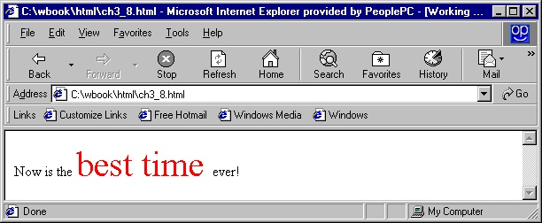
The <span> tag is similar to other HTML tags, they can be nested and they have id and class attributes
Example
Another tag that is useful for style specifications: <div>
Used to create document sections (or divisions) for which style can be specified
  e.g., A section of five paragraphs for which you want some particular style

Slide 51
Conflict Resolution
Two different values for the same property on the same element creates conflict for browser
This conflict can be resolve by three different levels of style sheets
Inline style sheet has precedence over document and external style sheet
Document style has precedence over external style sheet
  E.g. h3 { color: blue; }
        body h3 {color: red;}
Inheritance is another source of potential property value conflicts. These can occur on a particular element has a property value assigned by a style sheet and inherits a value of same property

Slide 52
For example FX2 has by default font size and browser allows to user to write their own style sheet. Property value of different origins has different precedence
Conflict resolution is a multistage sorting process which has precedence
  Important declarations with user origin
  Important declarations with author origin
  Normal declarations with author origin
  Normal declarations with user origin
  Any declaration with browser origin

Slide 53
Highest precedence
  Id selector
  Class and pseudo selector
  Contextual selector
  Universal selector
If still conflict arise most recent seen specification will be followed
  p { font-size: 12 pt; }
  p { font-size: 10 pt; }
The whole sorting process that is used to resolve style specification conflicts is called the cascade

Slide 54
2. Develop and demonstrate the usage of inline and external style sheet using CSS.
Solution:Use different selectors (Different headings, paragraphs etc.) for inline and external styles for a HTML file of Indian cricket team.
Also show some selectors precedence over other.
The page contains brief achievements of Indian team (Word cup wining or Defeat opponent team with huge run rate/ Victory happen due to good partnership of players etc.).
Specify Indian cricket color code with suitable picture / image. Specify Team members name with ordered list.

Slide 55
Also mention bating and bowling order. Use different form of styles (simple, class, generic, id etc.) for writing above information.
Use span or div tag for identifying captain, coach, wicket keeper. Create a table for top players highest runs or wicket taken, no of 50’s and 100’s.
Use alignment of text property and box model style concept to develop this table.
Use background image property if necessary.

Slide 56

Questions???

